Slide 1
Online Book Store Data Analysis Using SQL
Insights & Trends Using SQL Queries

Slide 2

Introduction
In today’s digital era, online book stores generate vast amounts of data related to books, customers, sales, and user interactions. Data analysis using SQL helps in extracting meaningful insights from this data to enhance business decisions and customer experiences.
Key Aspects of Data Analysis in an Online Book Store:
Sales Analysis – Identifying best-selling books, seasonal trends, and revenue patterns.
Customer Behavior – Understanding user preferences, purchase history, and retention rates.
Inventory Management – Tracking stock levels and predicting demand.
Marketing Insights – Analyzing promotional campaign effectiveness.
User Engagement – Studying browsing patterns and reviews for better recommendations.

Slide 3
OBJECTIVE
Efficient Data Management – Store and organize book, customer, and sales data systematically.
Sales Performance Analysis – Identify top-selling books, revenue trends, and seasonal demands.
Customer Insights – Understand customer preferences, buying behavior, and retention strategies.
Inventory Optimization – Monitor stock levels and predict demand to prevent shortages.
Personalized Recommendations – Use SQL queries to analyze past purchases and suggest relevant books.
Marketing Strategy Enhancement – Assess the effectiveness of promotions and discounts.
Real-time Reporting – Generate automated reports for better decision-making.

Slide 4
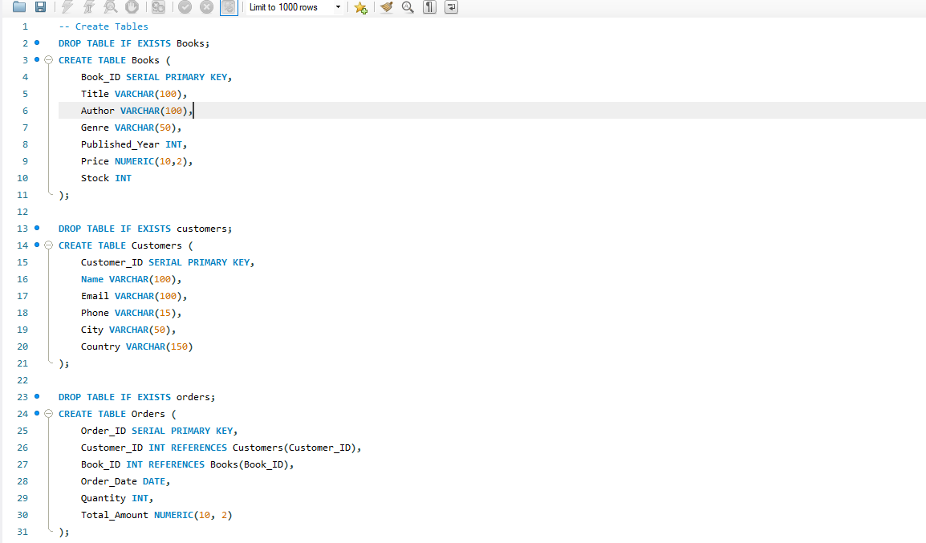
Dataset Overview

Slide 5
Business Problems
Retrieve all books in the "Fiction" genre ?
Find books published after the year 1950 ?
List all customers from the Canada ?
Show orders placed in November 2023 ?
Retrieve the total stock of books available ?
Find the details of the most expensive book ?
Show all customers who ordered more than 1 quantity of a book ?
Retrieve all orders where the total amount exceeds $20 ?
List all genres available in the Books table ?
Find the book with the lowest stock ?
Calculate the total revenue generated from all orders ?
Retrieve the total number of books sold for each genre ?
Find the average price of books in the "Fantasy" genre ?
List customers who have placed at least 2 orders ?
Find the most frequently ordered book ?
Show the top 3 most expensive books of 'Fantasy' Genre ?
Retrieve the total quantity of books sold by each author ?

Slide 6
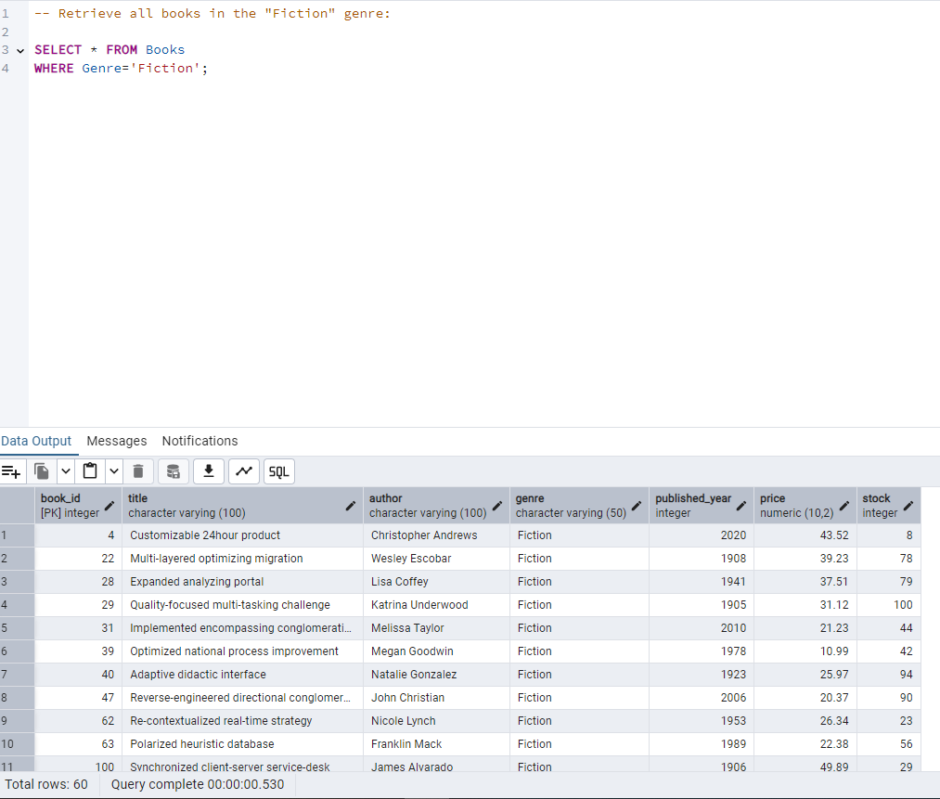
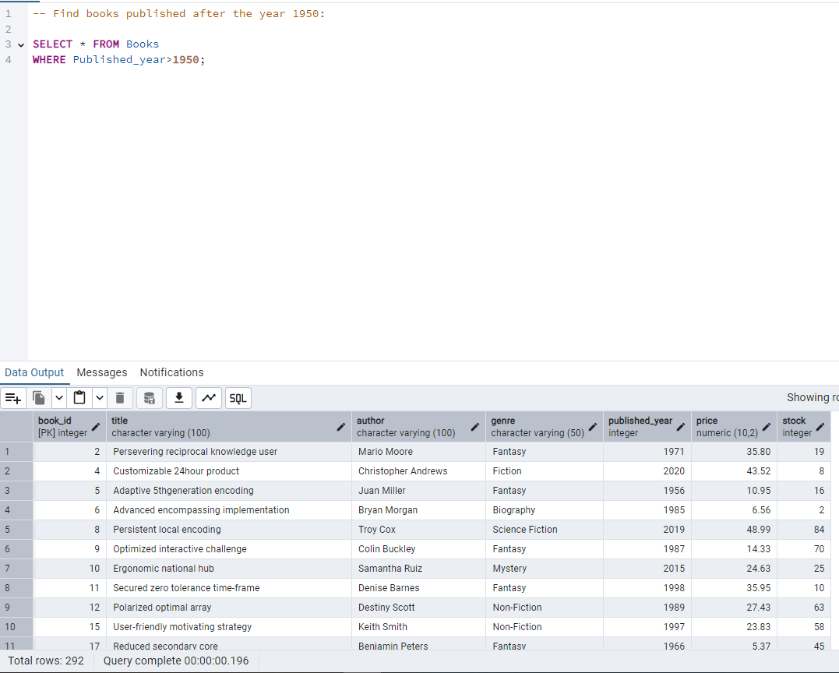
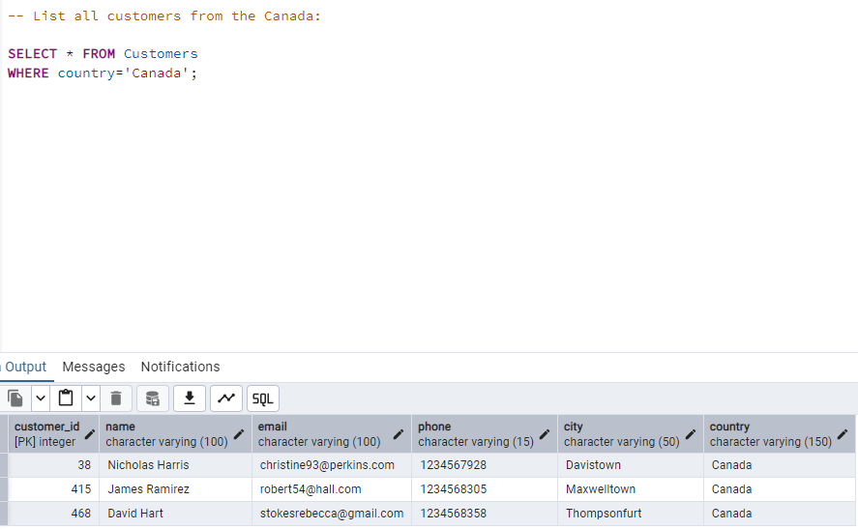
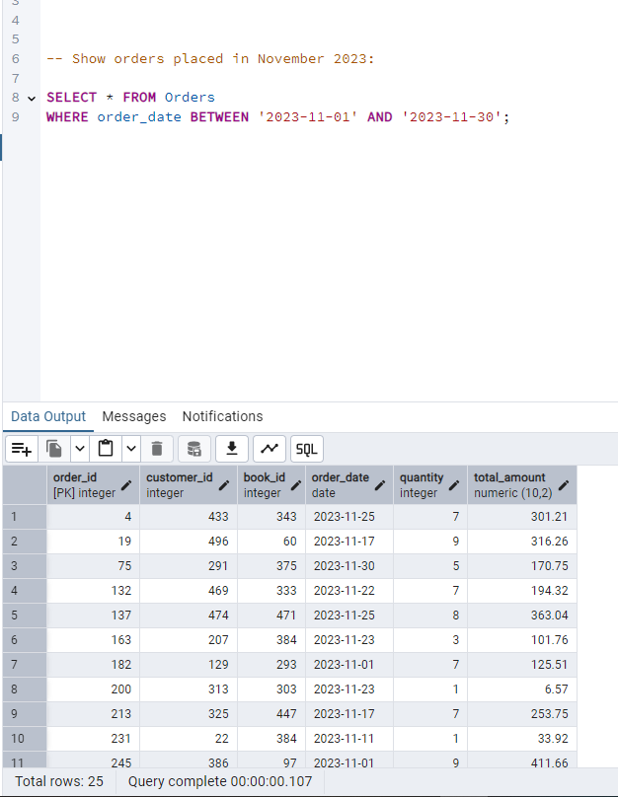
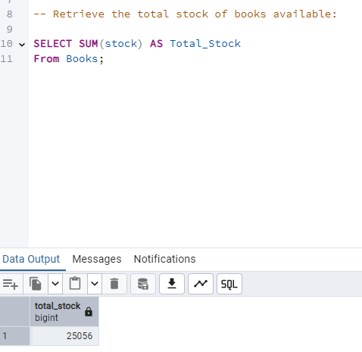
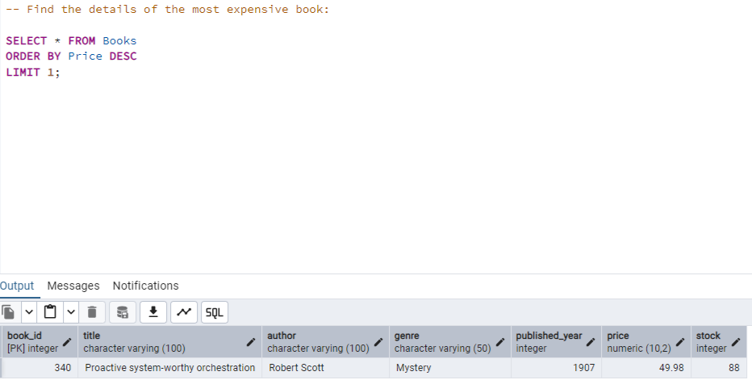
Case Study

Slide 7
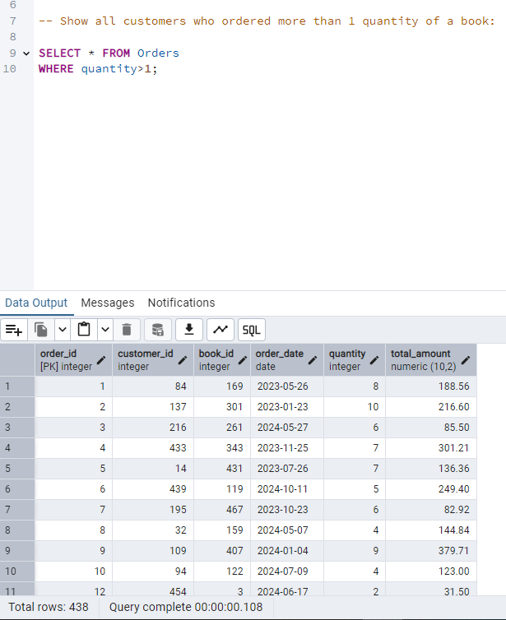
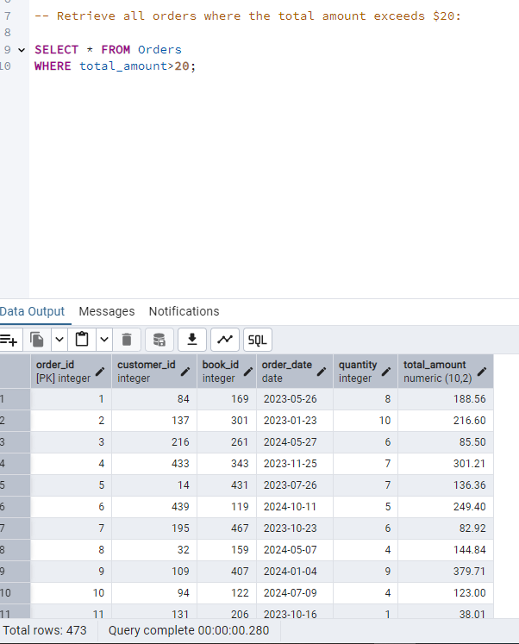
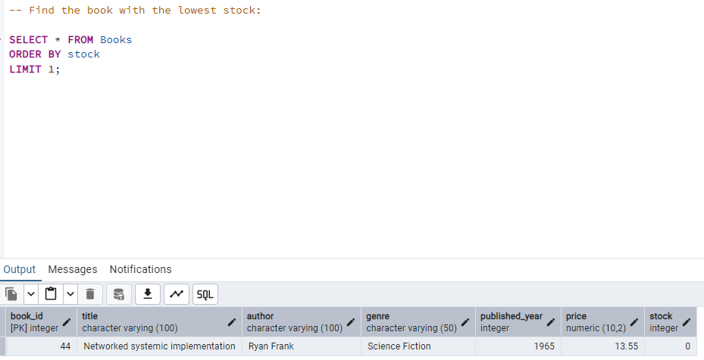
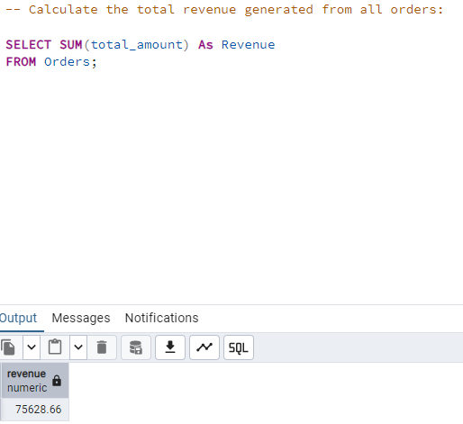
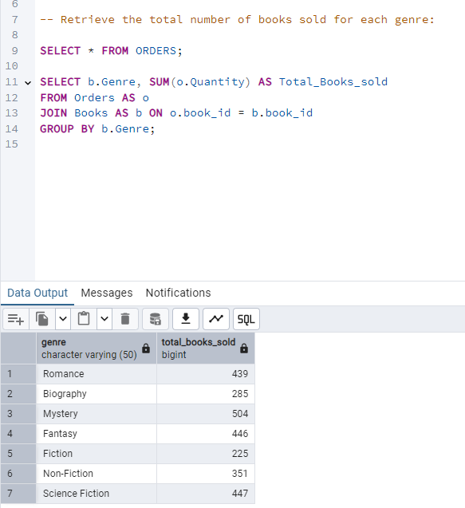

Slide 8
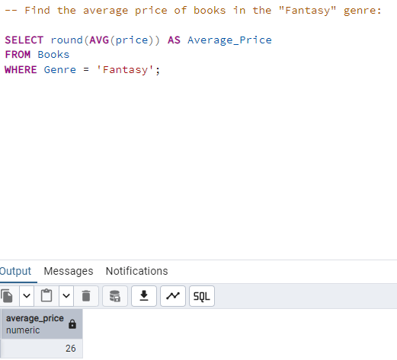
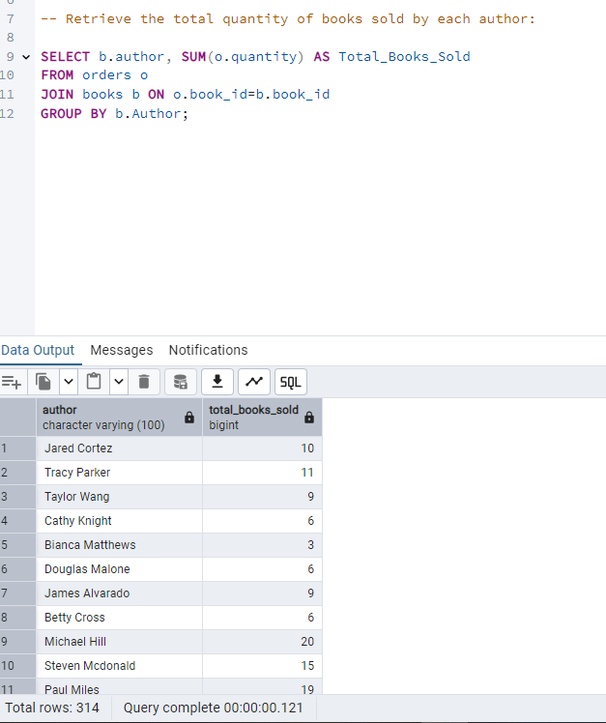
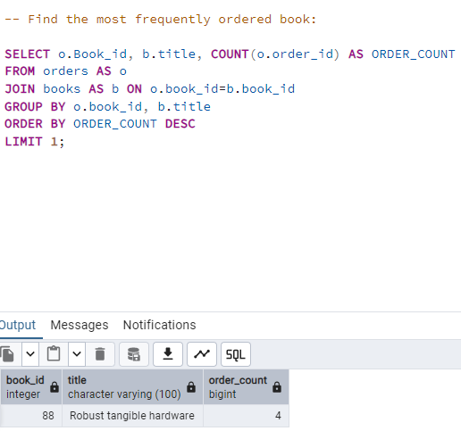
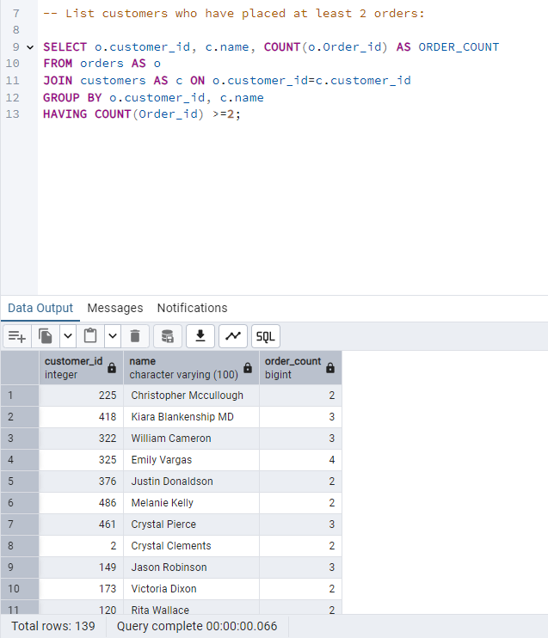
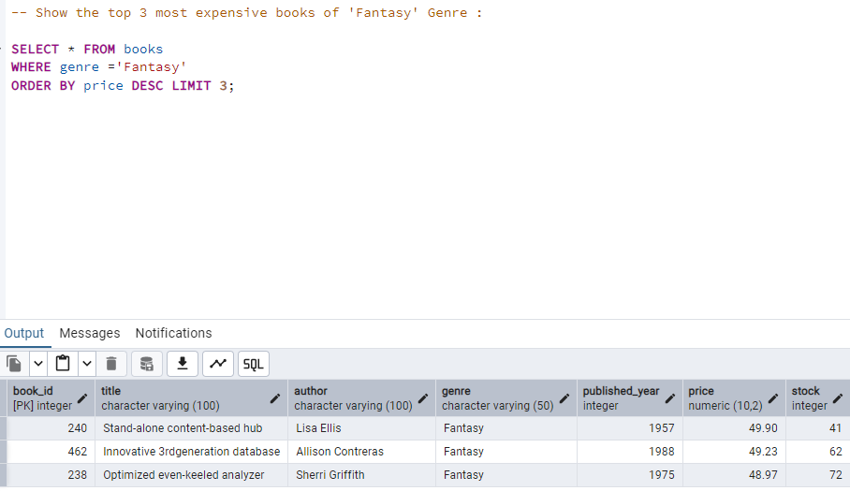

Slide 9
Advantages of SQL in Data Analysis for Online Book Store
Efficient Data Retrieval: SQL allows for fast querying of large datasets, making it easier to retrieve and analyze book sales, customer trends, and stock levels.
Scalability & Performance: SQL databases handle millions of records efficiently, making them ideal for growing e-commerce businesses. The online book store can analyze years of sales data without performance issues.
Structured Data Organization: SQL organizes data into structured tables, making it easy to access, filter, and relate information. Example: Linking orders, customers, and books in a relational database.
Data Accuracy & Integrity: SQL ensures data consistency by maintaining relationships between tables through Primary Keys and Foreign Keys. Helps prevent duplicate or missing data in customer orders.
Real-Time Data Analysis : SQL enables real-time data updates, allowing businesses to track live orders and sales trends. Example: Checking the latest sales revenue for today.
Cost-Effective & Open-Source Options: Many SQL databases like MySQL, PostgreSQL, and SQLite are free and open-source, reducing costs. Suitable for small and medium-sized businesses without high investment in software.

Slide 10
Challenges & Solutions
Large Volume of Data
Challenge: As the online book store grows, the database size increases, leading to slower queries and performance issues.
Solution
Optimize queries using Indexes to speed up search operations.
Use Partitioning to split large tables for better performance.
Complex Query Execution
Challenge: SQL queries for customer behavior analysis or sales trends can become too complex, affecting performance.
Solution:
Use VIEWs to simplify complex queries.
Break down queries using sub queries or Common Table Expressions (CTEs) for better readability.
Data Duplication & Inconsistencies
Challenge: Duplicate or inconsistent data (e.g., multiple entries for the same customer) can lead to incorrect analysis results.
Solution:
Use Primary Keys & Unique Constraints to enforce data integrity.
Apply Normalization to remove redundant data.
Implement data cleaning techniques using SQL.

Slide 11
Conclusion
SQL-based data analysis has transformed the way online book stores operate by enabling:
Efficient sales tracking to identify top-selling books and customer preferences.
Improved inventory management to prevent stock shortages or overstocking.
Better customer engagement through personalized recommendations and loyalty programs.
Data-driven decision-making, allowing businesses to plan marketing campaigns effectively.
Real-time insights into revenue, peak shopping hours, and seasonal sales trends.

